Slide 1

Autonomous Library Management System
HOLY MARY INSTITUTE OF TECHNOLOGY & SCIENCE
(Approved by AICTE, Affiliated to JNTU Hyderabad, Accredited by NAAC 'A' grade)
Bogaram (V), Keesara (M), Medchal Dist. – 501 301
DEPARTMENT OF COMPUTER SCIENCE AND ENGINEERING
Batch: A9
BY:
B.ABHISHEK(18C91A0509) C.K.S.RUTHWIK(18C91A0513) G.DIKSHETHA(18C91A0526)
GUIDE :
Mrs.CH.TULASI RATNA MANI. M.Tech
Assistant Professor

Slide 2
ABSTRACT
The prevailing practises in the library are, the borrower picks up a book according to their choice and they forget to return the books by the due date. In addition to this, there is a high risk of data loss due to software corruption, human error and physical damage. In order to prevent this the project’s goal is to design and develop web based software to overcome data loss using cloud services. To create borrower accounts, which notify borrowers the due date and give information about availability of a particular book, also provide an option to pre register the book.

Slide 3
SYSTEM ANALYSIS
In system analysis we discuss and analyse about the developing process of Autonomous Library Management System by studying the following:
Existing system
Disadvantages of existing system
Proposed system
Advantages of proposed System
Hardware Requirements
Software Requirements

Slide 4
EXISTING SYSTEM
The existing Library Management System (LMS) only provide the admin/librarian accounts , and are only limited to admin interfaces, they do not have user/borrower accounts, even the existing interfaces are designed poorly and are mostly outdated.
The existing LMS systems are either completely dependent on the system for all it’s functionalities or are dependent on a local server, and have poor security.

Slide 5
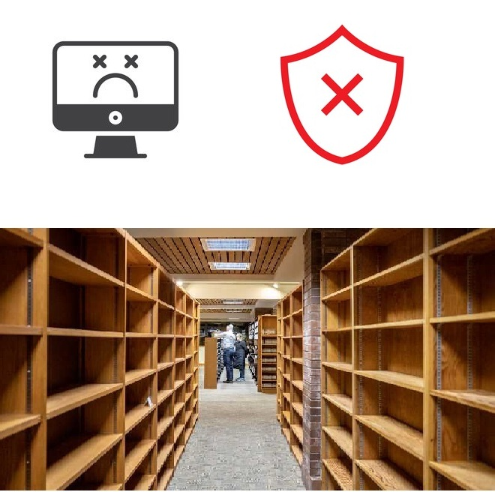
EXISTING SYSTEM (DISADVANTAGES)
The problem with the existing system is that, all the library data (including the data of all the books and borrowers) may get lost due to data corruption, Physical damage of the system, and low to none security protocols
The secondary problem of existing system is most of the borrowers forget the due date to return the books due to which managing a library becomes difficult.

Slide 6
PROPOSED SYSTEM
The proposed LMS system provides both admin/librarian and user/borrower accounts with refind, sleek and latest interface and design elements.
The proposed system is implemented using cloud services, and is designed in such a way that it can be implemented using most of the cloud service providers.
Proposed system also supports uploading large amount of either books or borrower data using a Comma Separated Values or CSV files.

Slide 7
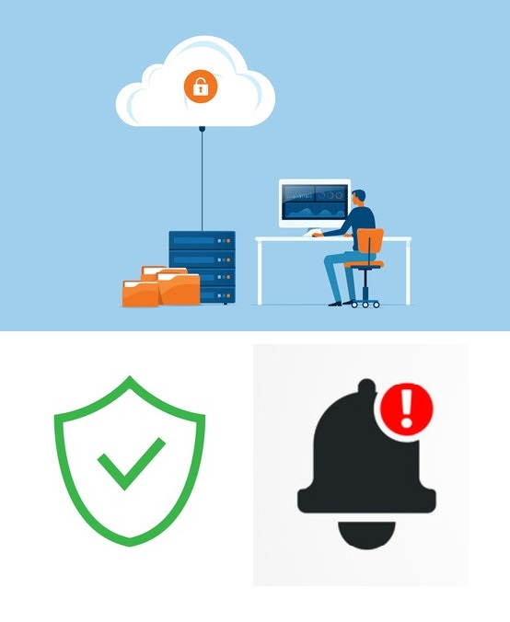
PROPOSED SYSTEM (ADVANTAGES)
The proposed system uses cloud services to implement the library management system which is safe and highly secure.
Implementing borrower profiles used to login to their accounts.
This proposed system also implements borrower notification, get notified on availability of a required book and also pre register a book.

Slide 8
SOFTWARE REQUIREMENTS
Operating System: Windows 7 or higher
Programming Languages: HTML, CSS, JavaScript, PHP
Cloud Service Provider: GitHub
Any Browser

Slide 9
HARDWARE REQUIREMENTS
Processor: Intel i3 Core 5th Generation
RAM: 8 GigaByte
Hard Disk: 128 GigaByte
Peripheral Devices:Monitor, Keyboard, Mouse
(MINIMUM)

Slide 10
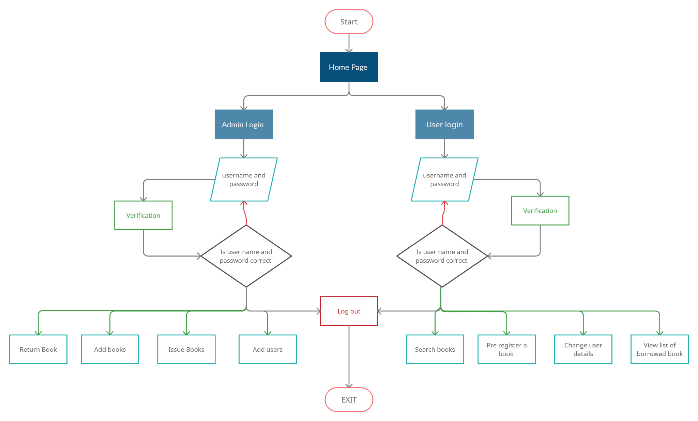
System Design

Slide 11
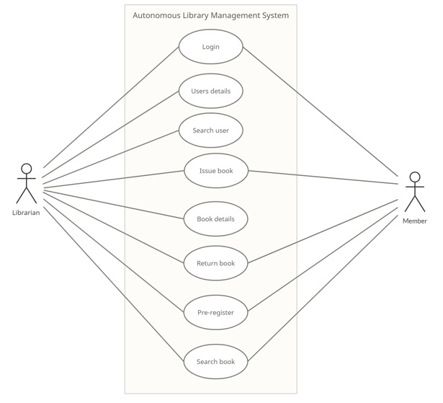
Use Case Diagram

Slide 12
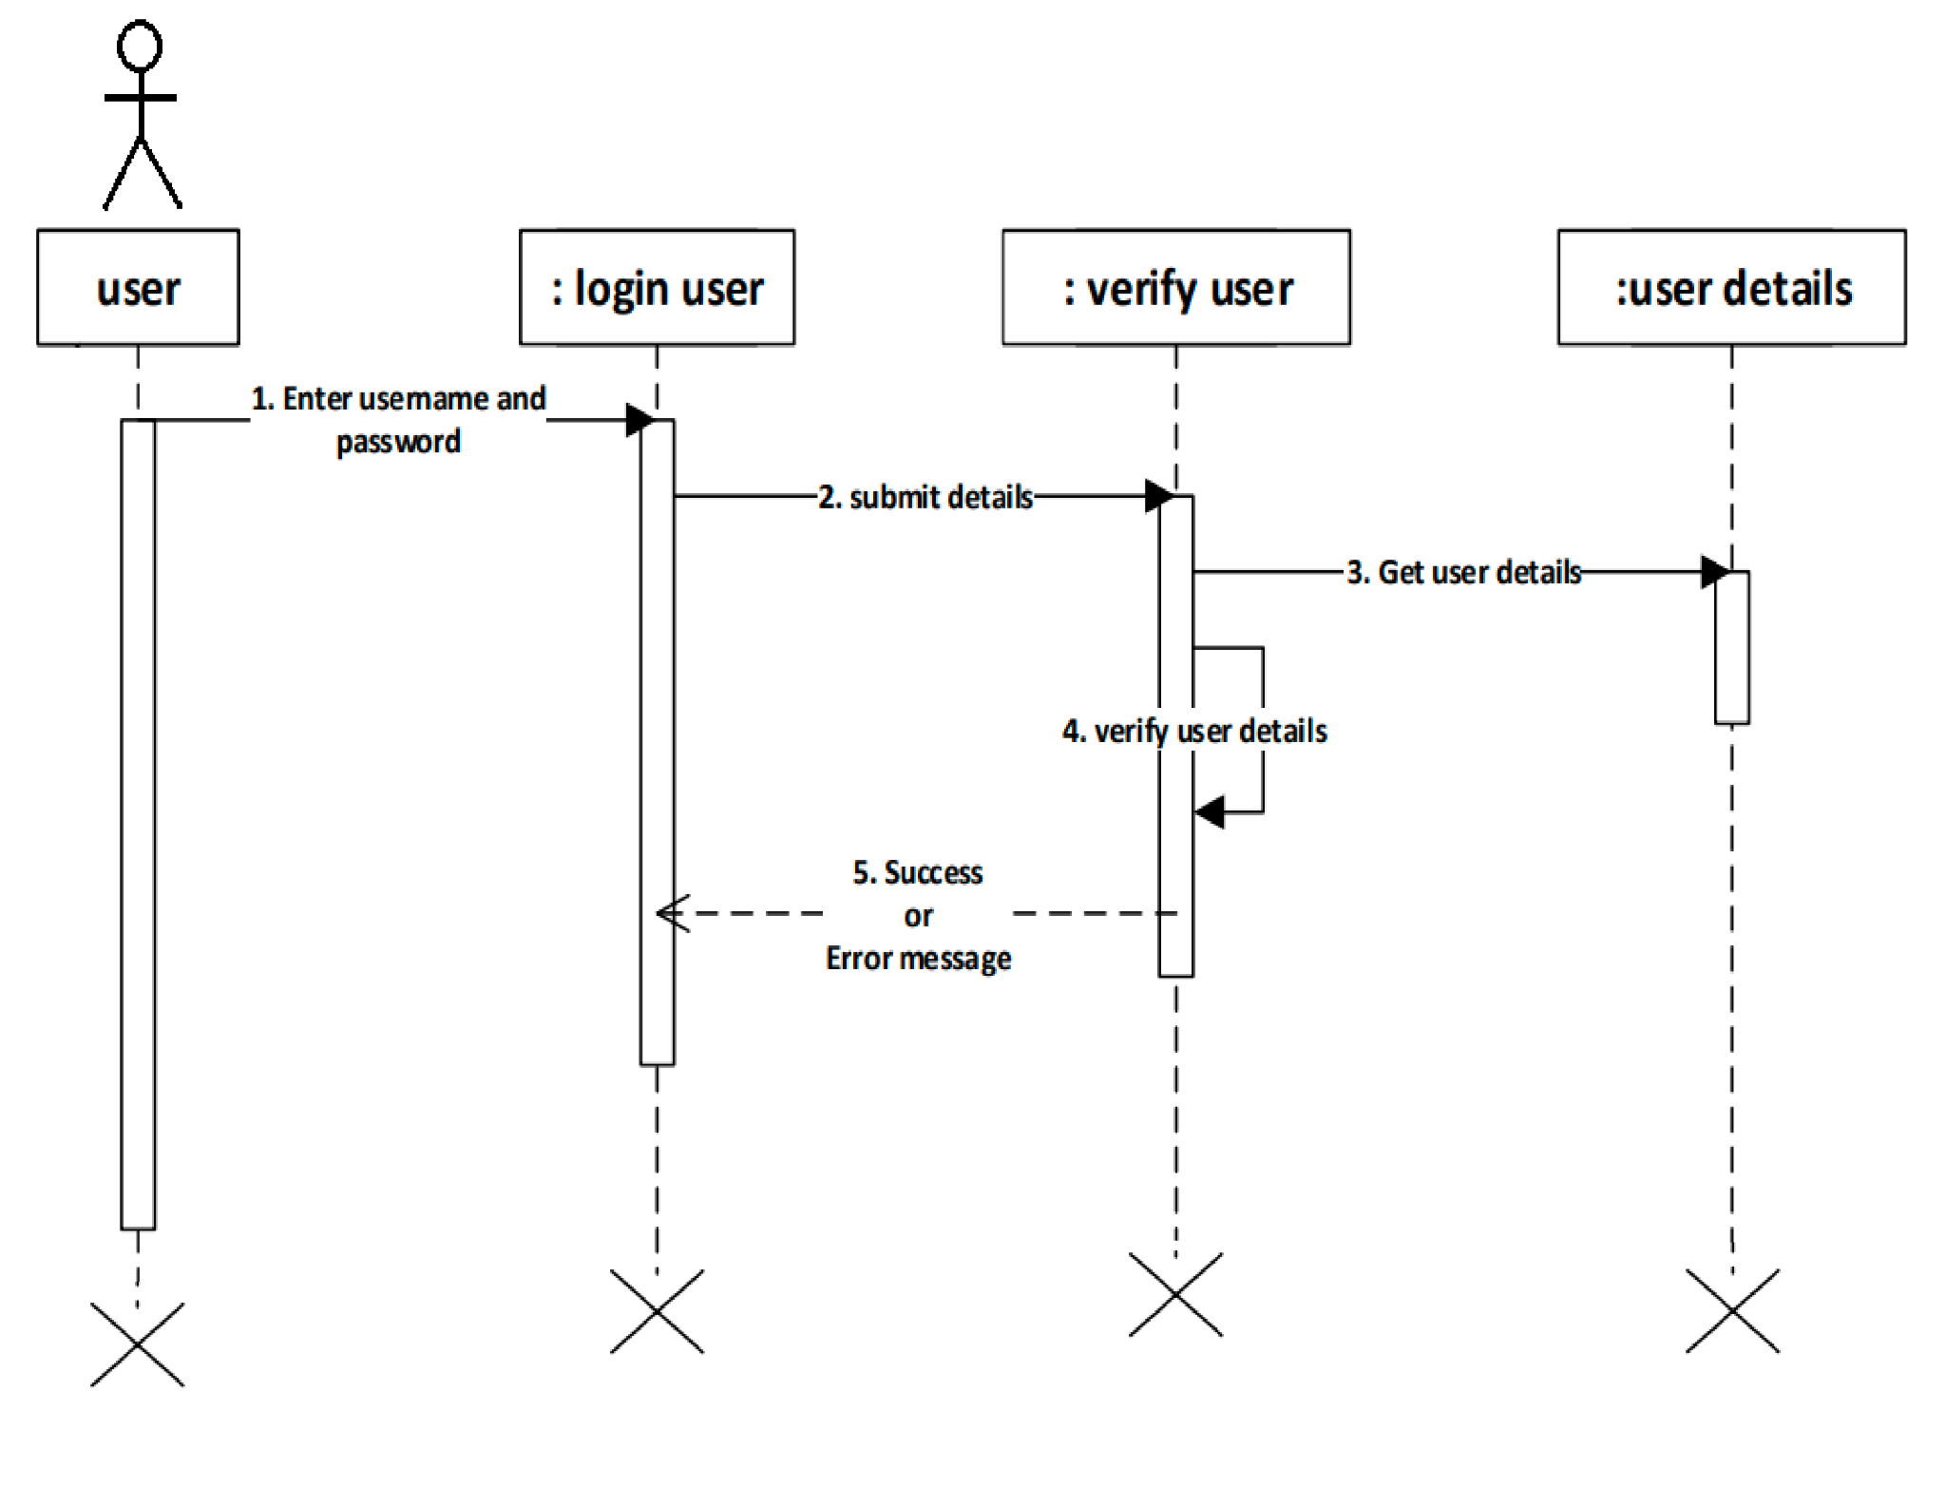
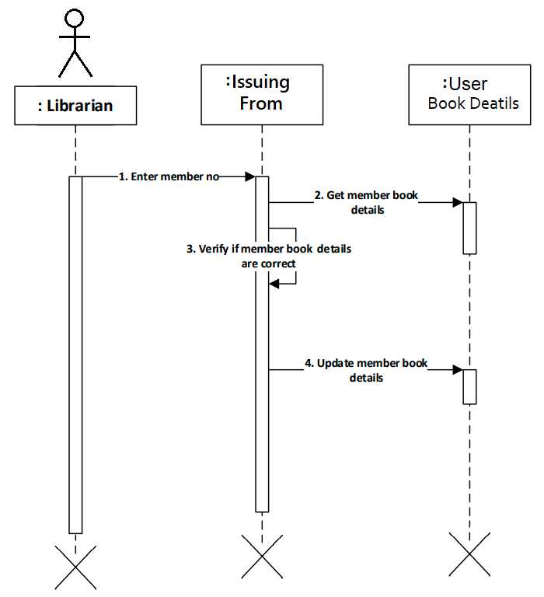
Login Sequence Diagram
Sequence Diagrams
Issue Book Sequence Diagram

Slide 13
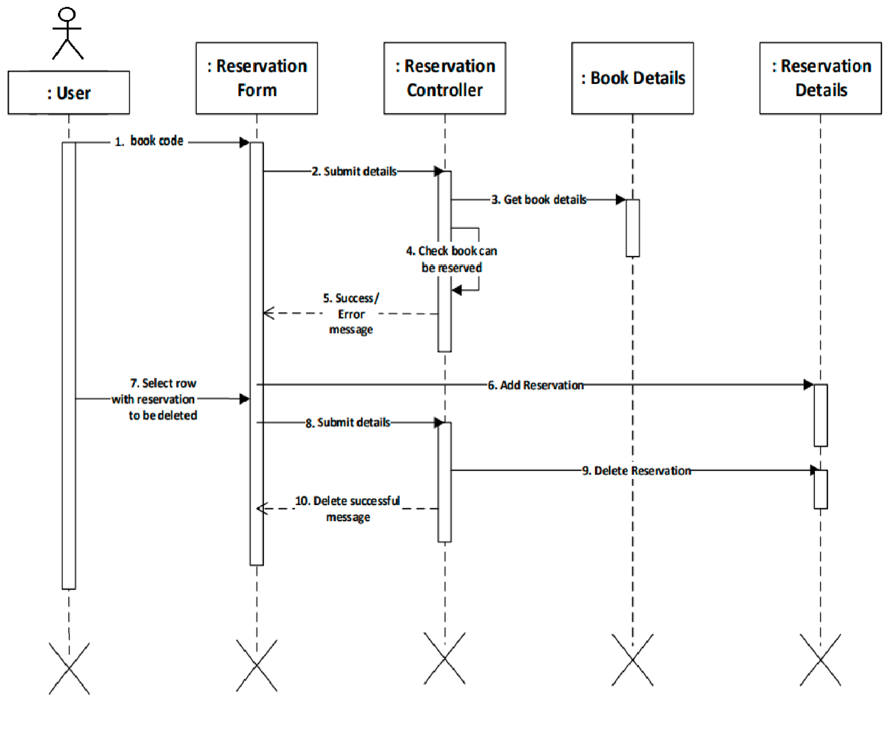
Pre Registration of a Book
Sequence Diagram
Return Book
Sequence Diagram

Slide 14
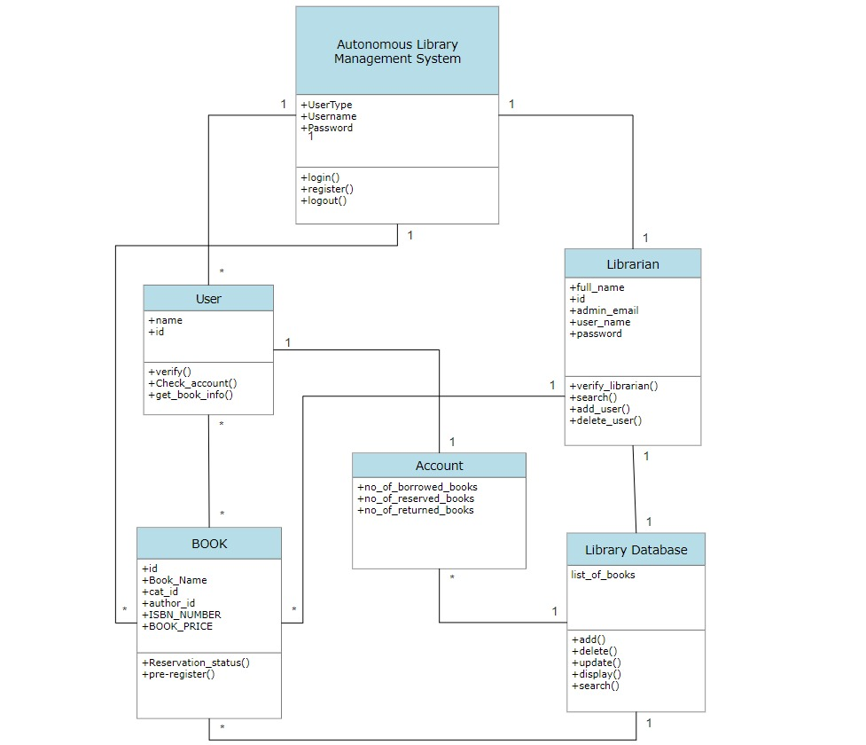
Class Diagram

Slide 15
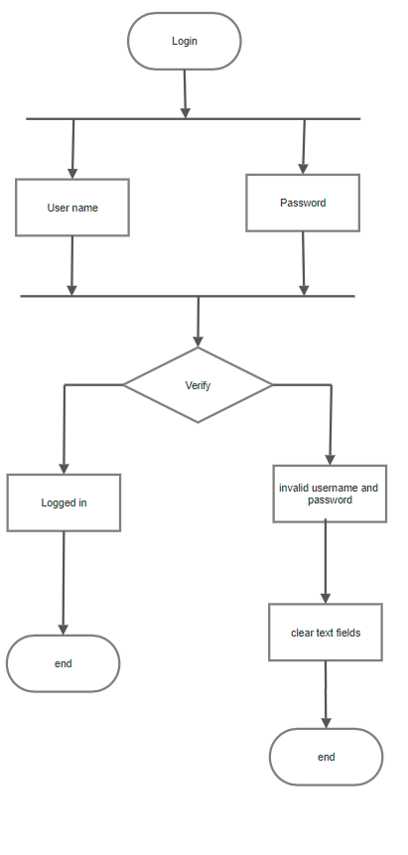
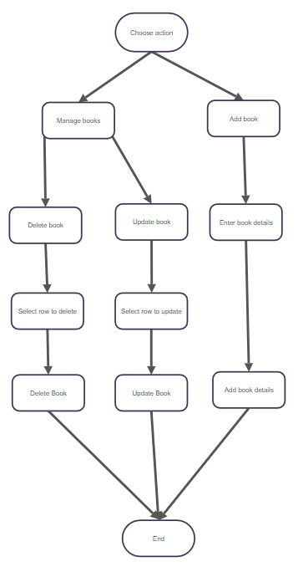
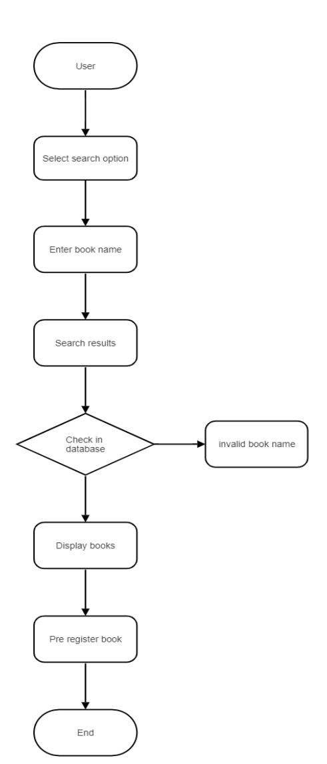
Activity Diagrams
Login
Maintain
Pre Registration

Slide 16
Autonomous Library Management System Implementation
A library management system is a software used to maintain a record of all the books present in the library and keep track of who are borrowing them and for how much duration, but most of the library management system softwares are poorly designed, their interface is outdated, data is not secure and their functionality is limited.
The implement Autonomous Library Management system is to overcome these issues and implement the a new, clean yet simple user interface, also to implement cloud services making this highly secure and to prevent data corruption, and add new functionalities

Slide 17
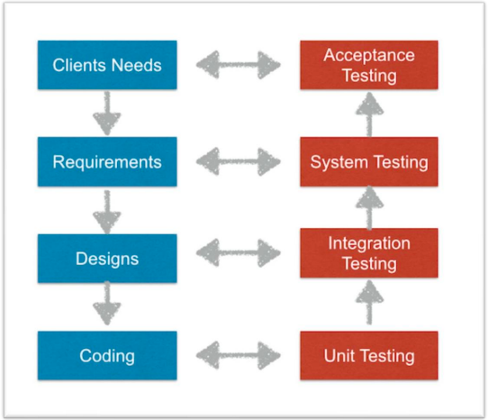
System Testing
Testing is one of the most important phases of a project, its main objective is to uncover/point most of the errors with minimum effort and time. Basically testing is process of executing the project to find errors
The best way to implement testing is by testing in levels as shown in the diagram.

Slide 18
RESULTS

Slide 19
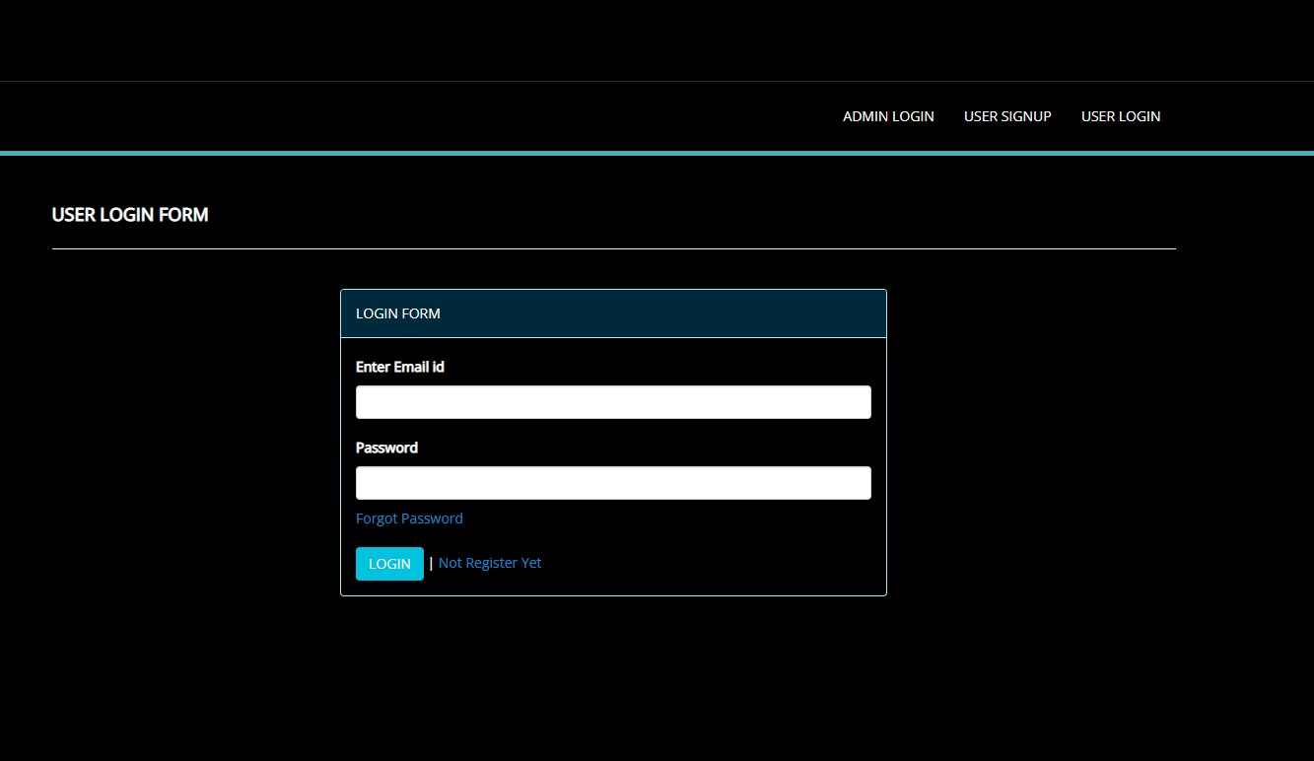
Autonomous Library Management System

Slide 20
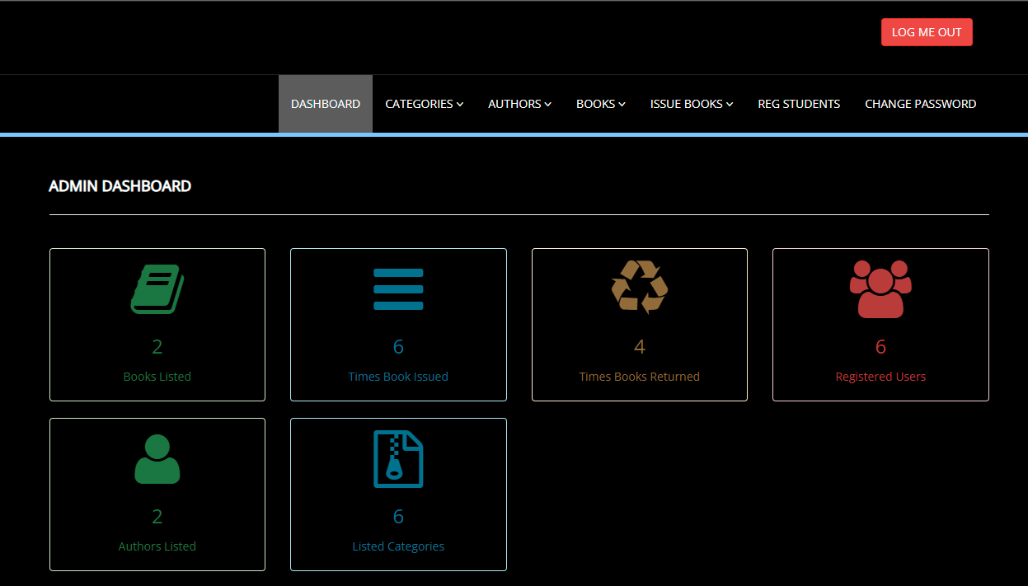
Autonomous Library Management System

Slide 21
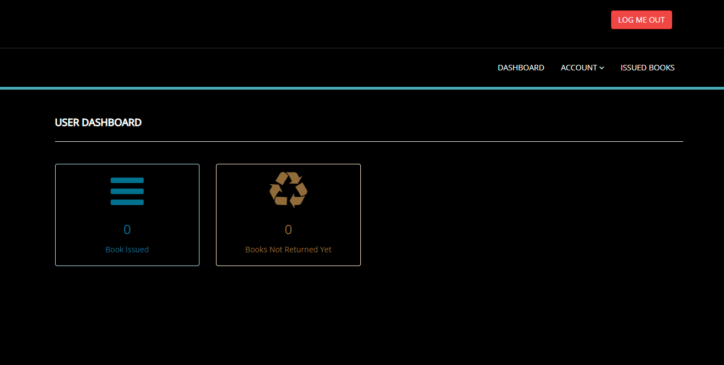
Autonomous Library Management System

Slide 22
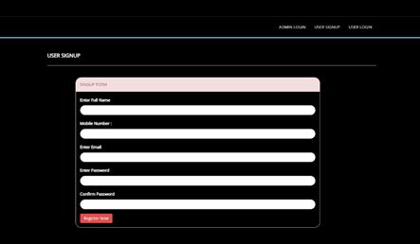

Slide 23
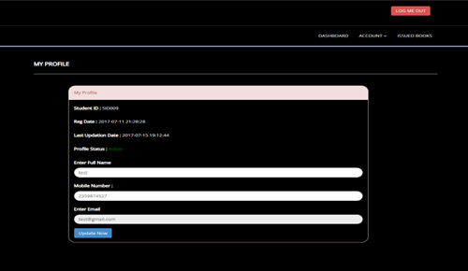

Slide 24
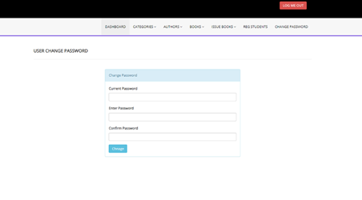

Slide 25
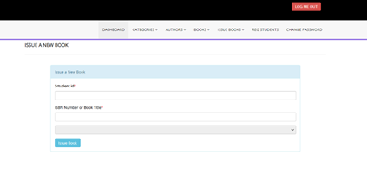

Slide 26
FUTURE SCOPE OF THE PROJECT
This Library Management System project covers most of the requirements of a LMS, the future scope of the project is :
To implement and integrate it into mobile applications and integrate features like notifications into devices like smart watches
To design a system where in times of unavailability of internet the changes made in data are automatically changed in the cloud server as soon as the internet connection is established
To implement Artificial intelligence and Machine learning algorithms to inform the librarian about when to arrange the books and what books to arrange in the book shelves based on syllabus of the the students and based on demand of the book.

Slide 27
CONCLUSION
In Conclusion the main aim of this project is to develop a library Management System that overcomes the drawbacks of the existing library Management Systems like:
To prevent data loss using cloud services.
Notify the borrowers the due date of the books they borrowed.
Also an option to be notified when a particular book is available.
Option to pre register a book.
This project uses AWS servers to host the project on the cloud, and it is developed using knowledge in fields like HTML, CSS, JavaScript, and MySQL. This project includes member accounts which improve the user interaction and makes it easy for the librarian to maintain the library, it’s books and also its members. As this system run on cloud servers we don't have to worry about data loss and data corruption due to physical damage of the computer, hence this system can be accessed from anywhere using a web browser, it is easy to maintain, it is also fully managed, secure, the scalability, availability and durability of the data is very high.

Slide 28
THANK YOU

